Slide 1
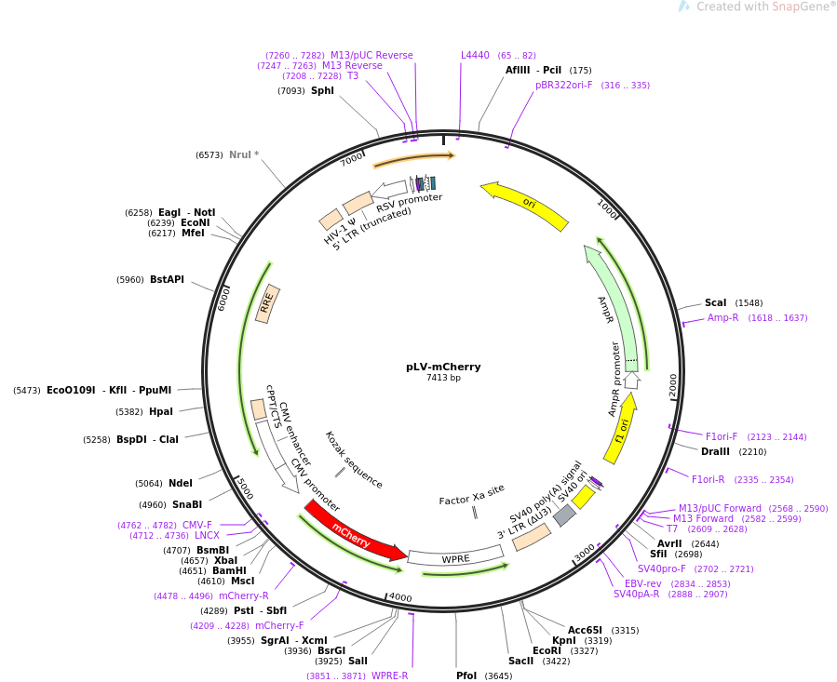
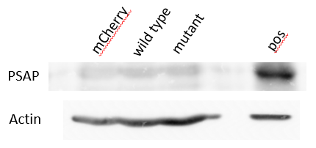
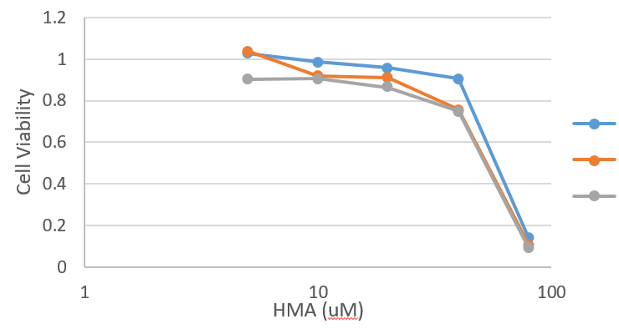
Investigating the role of saposin B in HMA-mediated toxicity toward breast cancer cells
Results
The western blot below shows that our transduced lines were not overexpressing Saposin B.
Madelyn Wheeler, MS4
University of California
Introduction
Therapy-resistant cancer cells can be targeted using novel cationic amphiphilic drugs such as HMA that induce lysosomal cell death. Parallel alteration of lysosomal protein Saposin B could sensitize cells to HMA, reducing off-target effects.
Consequently, there was no difference in HMA toxicity.
mCherry
Hypothesis
WT
Mutant Saposin B will potentiate HMA treatment in breast cancer cells.
Main Finding: The model used is ineffective in testing our hypothesis.
mut
Methods
A plasmid construct was created for wild-type and mutant saposin B overexpression.
Breast cancer cell lines were transduced with either construct.
Cell viability assays with treated cells were used to determine the EC50.
A dextran release assay was used to evaluate lysosomal membrane permeabilization.
Discussion
Transfected Hek293s did show significant overexpression of Saposin B, so it is likely that viral transduction was not efficient enough. Successfully transduced clones could not be selected due to the lack of mCherry, and additionally, they could be less viable. A different vector is needed that is both inducible and provides a drug selection factor.
QR code linking to full abstract or manuscript = >>>>>

